Slide 1
STRASTech
Electronics Overview
Proof-of-Concept Prototype

Slide 2

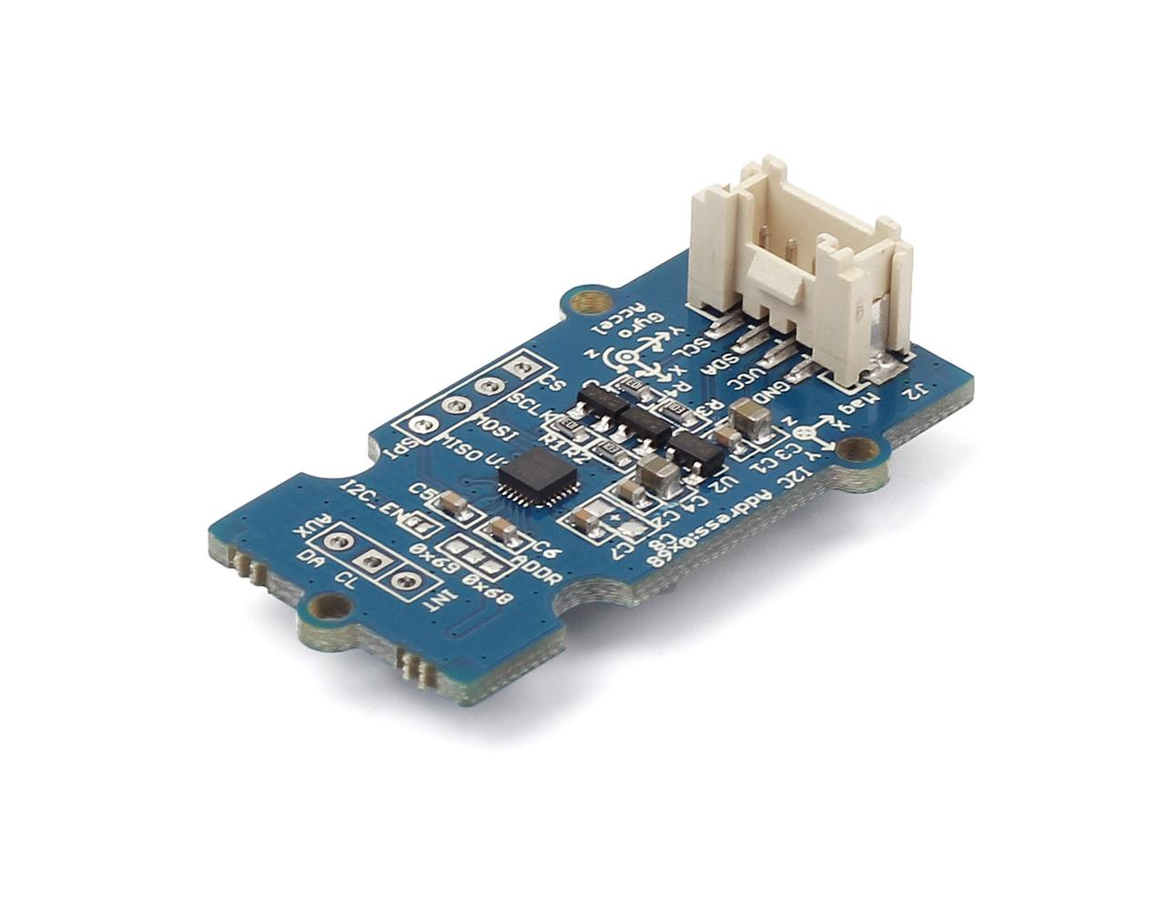
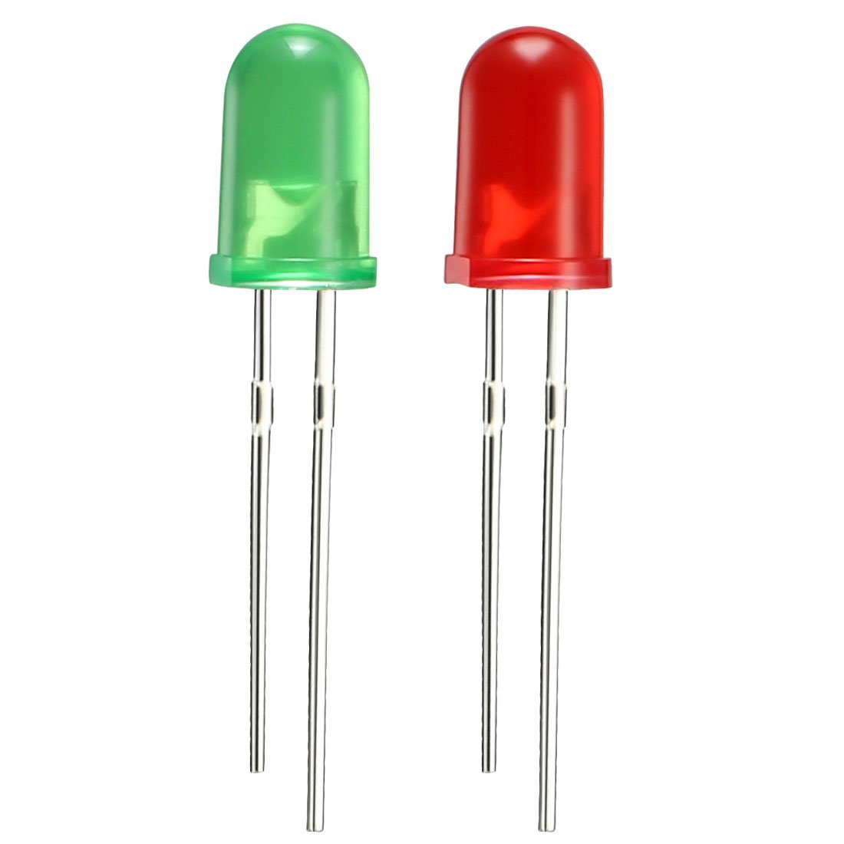
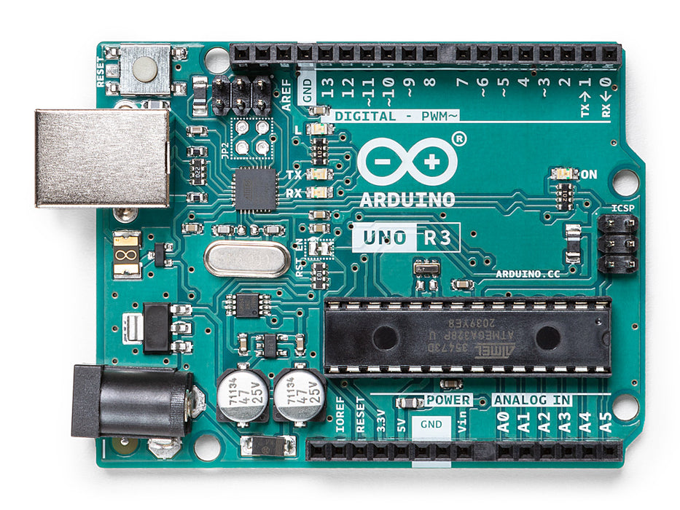
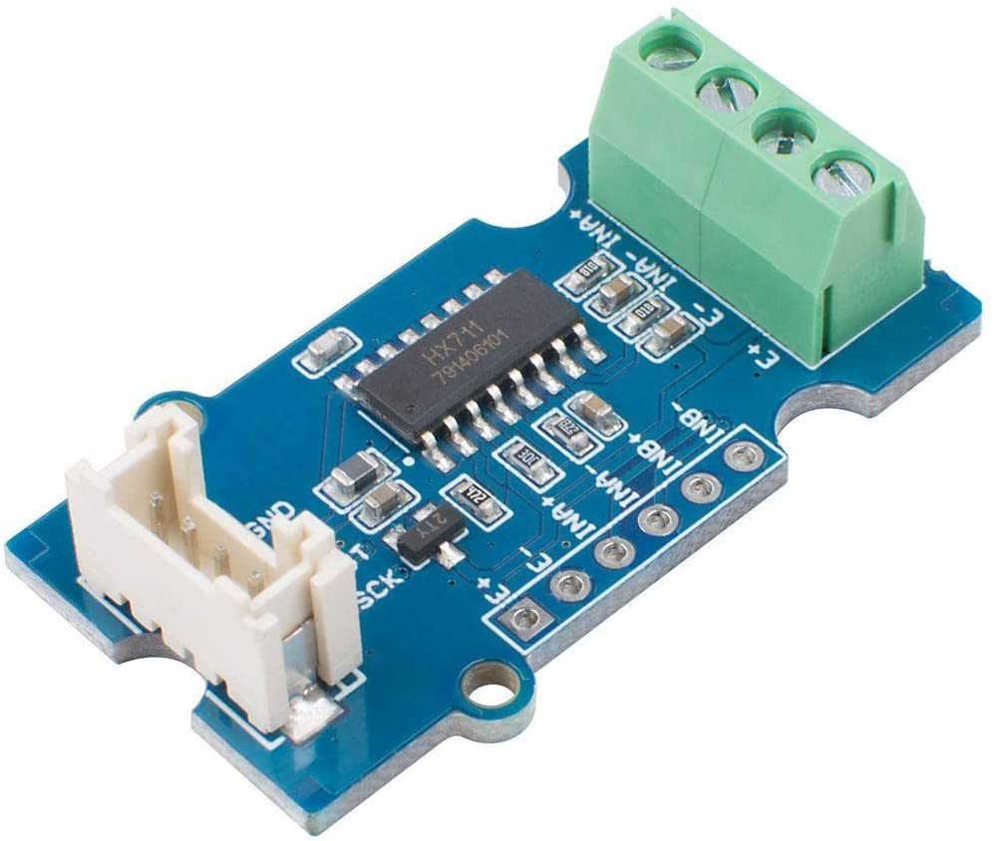
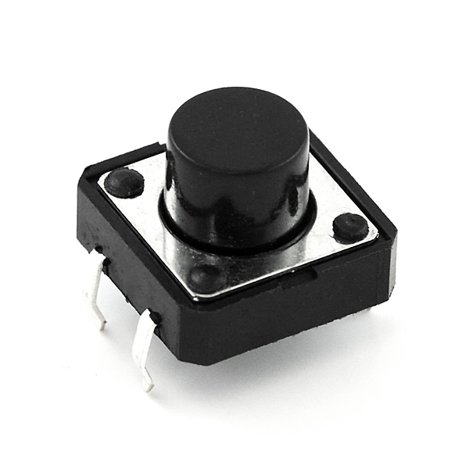
Electronics
Host Computer
Start/Stop LED
9 Axis IMU (x2)
Start/Stop Button
HX711 Load Cell Amp
Arduino UNO

Slide 3
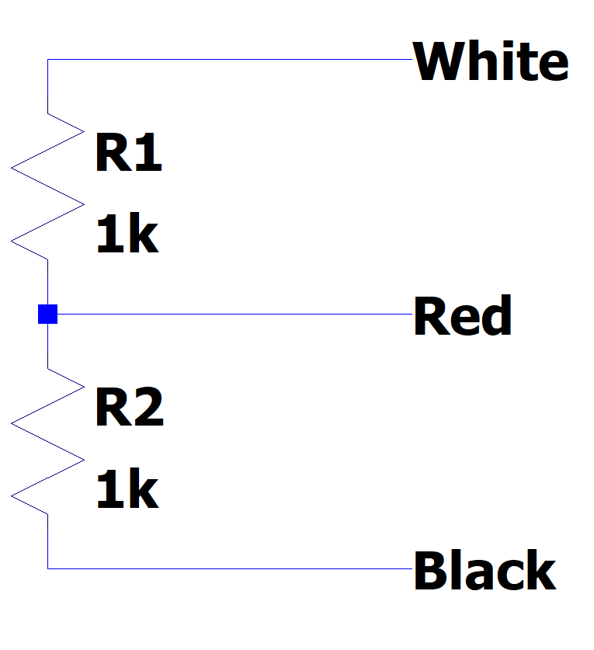
Electronics – Load Cell

Slide 4
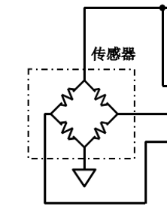
Electronics – Load Cell Bridge
5V
Load Cell #1
Load Cell Amplifier
Load Cell #2

Slide 5
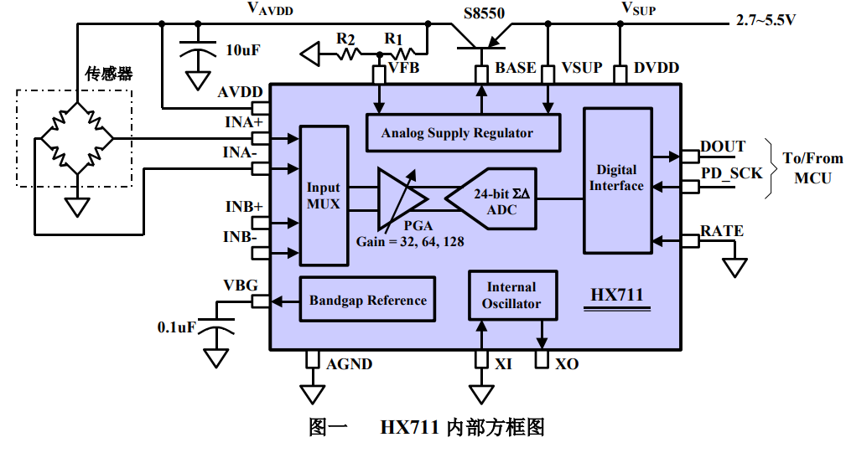
Electronics – HX711
RATE=1, 80 Samples/s
RATE=0, 10 Samples/s

Slide 6
Electronics – IMU
Accelerometer
Gyroscope
Measure acceleration due to gravity when stationary
Measure translational acceleration during motion
How can we differentiate the two?
Measure angular (not translational) velocity
Suffers from drift (reading a constant value even when still)
Communicate to Arduino over I2C, allows both shin and foot IMU to use the same bus, with different addresses.
Arduino
Foot IMU
Shin IMU
Other Stuff (Future)
SCL
SDA

Slide 7
Electronics – Firmware
Entry
Init Foot/Shin IMU
Red LED On
Button Pressed?
Button Pressed?
Green LED On
Get one frame of data, send to PC

Slide 8
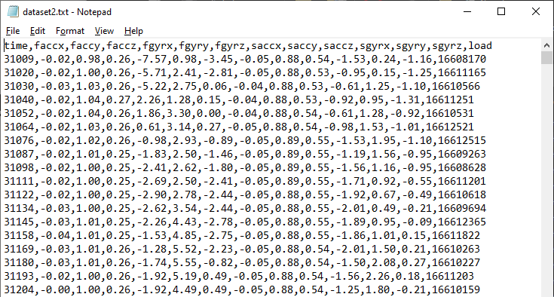
Electronics – Data Format

Slide 9
Software – Overview
STRASAnkle.exe
Serial Port to .CSV
Filename.txt
MATLAB
USB
#1
Dataset_yyyy_mm_dd_hh_mm_ss.txt
#2

Slide 10
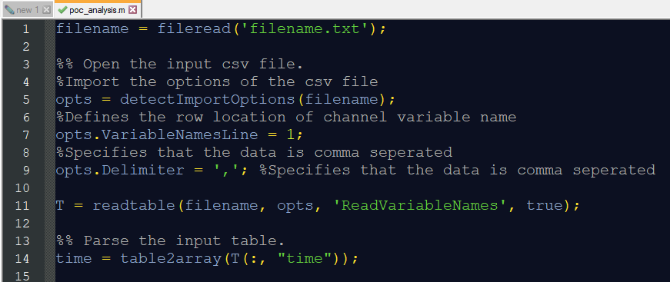
Software – Joint Angle Algorithm

Slide 11
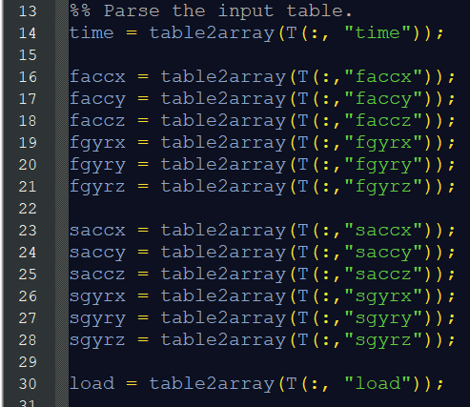
Software – Joint Angle Algorithm

Slide 12
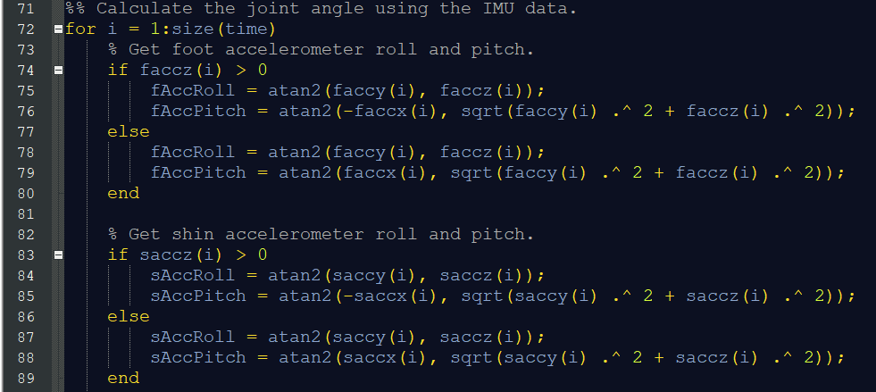
Software – Joint Angle Algorithm

Slide 13
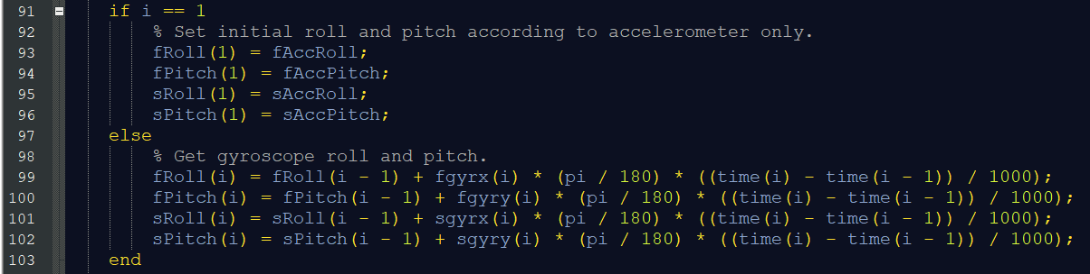
Software – Joint Angle Algorithm

Slide 14
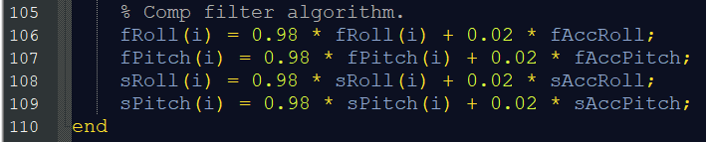
Software – Joint Angle Algorithm

Slide 15
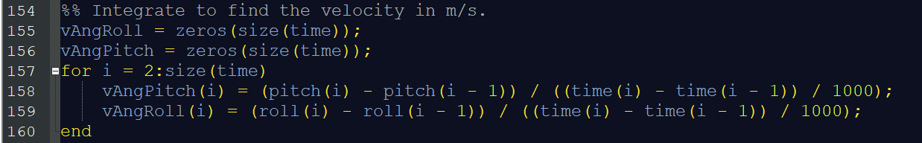
Software – Angular Velocity Algorithm

